Slide 1
PROCEDURAL PROGRAMMING IN C
SMART ELDERLY CARE
PROJECT BY :
PARVATHY KRISHNA A
SHRUTHI SHRI
SUMITRA S
V SANJANA
CB.SC.U4CSE23739
CB.SC.U4CSE23746
CB.SC.U4CSE23749
CB.SC.U4CSE23751

Slide 2

01
EMERGENCY PANIC BUTTON SYSTEM
Parvathy Krishna A
CB.SC.U4CSE23739

Slide 3
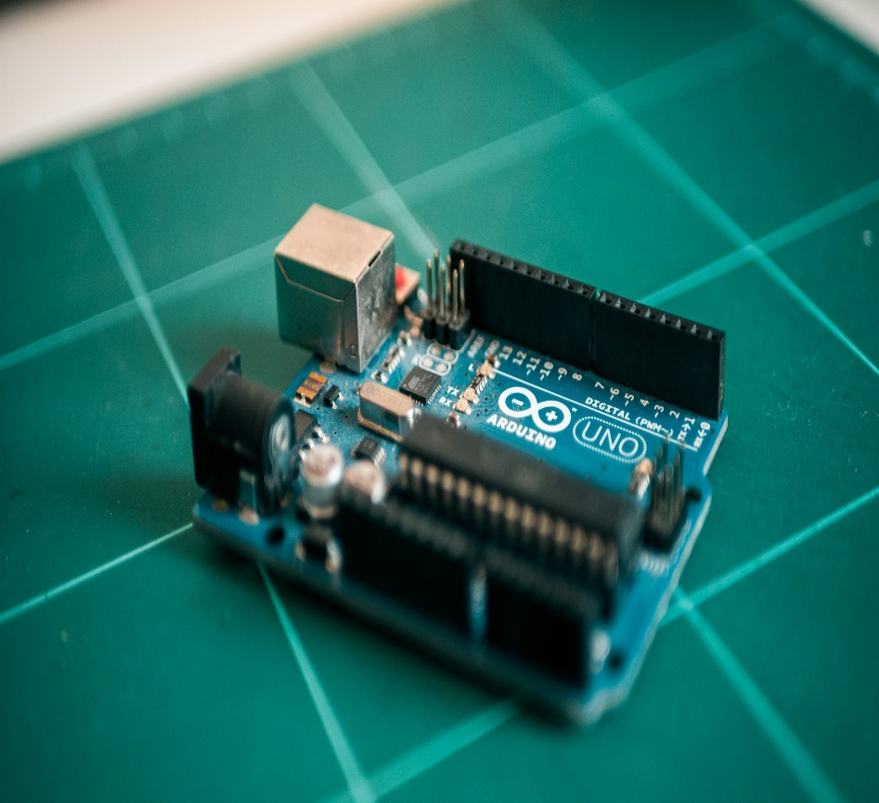
Introduction
The project involves creating a simple interactive system using an Arduino microcontroller, designed to respond to user input through a push button. By integrating a button, an LED, and a buzzer, the setup provides immediate visual and auditory feedback when the button is pressed. This foundational project showcases the principles of digital input and output, emphasizing the importance of user interaction in electronics.

Slide 4

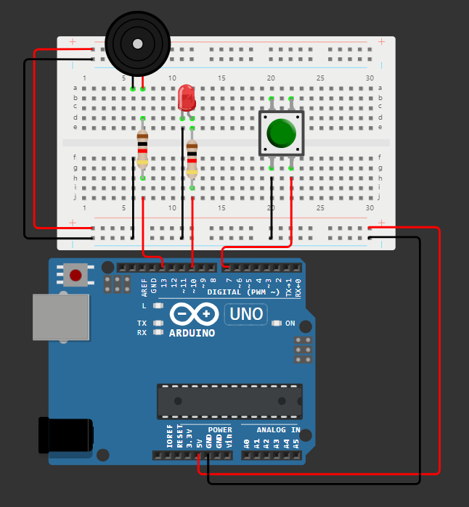
CIRCUIT DESIGN
LED
Push Button
Buzzer
Resistor
Arduino Uno
https://wokwi.com/projects/412815710589040641

Slide 5
CONNECTIONS
Button: Connect one terminal to the specified pin (e.g., pin 7) and the other to ground. If using a pull-up resistor, connect the pin to Vcc (5V) through a resistor and the button to ground.
LED: Connect the anode (longer leg) to the specified pin (e.g., pin 10) and the cathode (shorter leg) to ground. A resistor (typically 220Ω) is used in series to limit current.
Buzzer: Connect one terminal to the specified pin (e.g., pin 13) and the other terminal to ground.

Slide 6
ALGORITHM
1. Define Structure: Create a GPIO_Pin structure for pin number and mode.
2. Initialize Pin: Implement initPin to set the pin mode.
3. Define Pins: Create GPIO_Pin instances for a button, LED, and buzzer.
4. Initialize Pins: Use initAllPins to initialize all GPIO pins.
5. Activate Functions:
5.1 Define:
5.1.1 activateLEDAndBuzzer: Turns on LED and plays buzzer tone.
5.1.2 deactivateLEDAndBuzzer: Turns off LED and stops tone.
5.2 Setup:
5.2.1 Initialize pins.
5.2.2 Start with LED and buzzer off.
5.3 Loop:
5.3.1 Check button state.
5.3.2 Activate/deactivate LED and buzzer based on button press.
5.3.3 Include a 10 ms delay for stability.

Slide 7
CODE
#include <Arduino.h>
// Define a structure for a GPIO pin
typedef struct {
uint8_t pinNumber; // Pin number
uint8_t mode; // Pin mode (INPUT/OUTPUT)
} GPIO_Pin;
// Initialize a GPIO pin by setting its mode
void initPin(GPIO_Pin *gpio) {
pinMode(gpio->pinNumber, gpio->mode); // Set the mode of the pin
}
GPIO_Pin button = {7, INPUT}; // Button on pin 7
GPIO_Pin led = {10, OUTPUT}; // LED on pin 10
GPIO_Pin buzzer = {13, OUTPUT}; // Buzzer on pin 13

Slide 8
// Function to initialize all GPIO pins
void initAllPins(GPIO_Pin *pins[], int count) {
for (int i = 0; i < count; i++) {
initPin(pins[i]); // Initialize each pin
}
}
// Function to turn on the LED and play the buzzer tone
void activateLEDAndBuzzer() {
digitalWrite(led.pinNumber, HIGH); // Turn on the LED
tone(buzzer.pinNumber, 1000); // Play a 1000 Hz tone
}
// Function to turn off the LED and stop the buzzer tone
void deactivateLEDAndBuzzer() {
digitalWrite(led.pinNumber, LOW); // Turn off the LED
noTone(buzzer.pinNumber); // Stop the tone
}

Slide 9
void setup() {
// Create an array of pin pointers
GPIO_Pin *pins[] = {&button, &led, &buzzer};
// Initialize all GPIO pins
initAllPins(pins, 3);
// Start with LED and buzzer off
deactivateLEDAndBuzzer();
}
void loop() {
// Check if the button is pressed
if (digitalRead(button.pinNumber) == HIGH) {
activateLEDAndBuzzer(); // Activate LED and buzzer
} else {
deactivateLEDAndBuzzer(); // Deactivate LED and buzzer
}
delay(10); // Small delay for stability
}

Slide 10
Applications
User Interfaces: Simple systems for user input using button controls.
Indicators: Visual (LED) and audio (buzzer) indicators for alarms or notifications.
Learning and Prototyping: Ideal for educational purposes and prototyping basic electronic circuits.
Games and Toys: Interactive games where buttons trigger sound and light effects

Slide 11
THANK YOU!

Slide 12



AUTOMATIC DOOR LOCKING SYSTEM
BY: SHRUTI SHRI A
ROLL NO: CB.SC.U4CSE2346

Slide 13

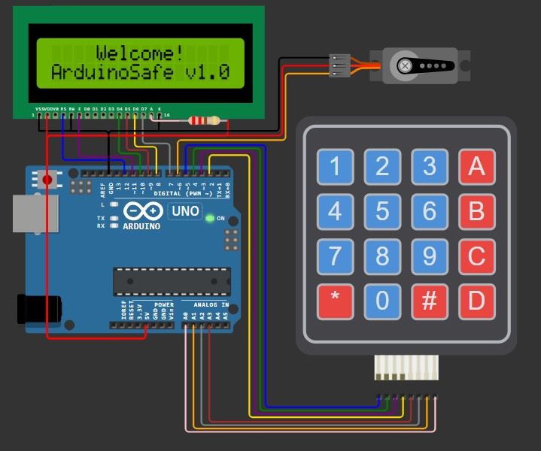
TINKERCAD DESIGN
https://wokwi.com/projects/411593347940831233

Slide 14

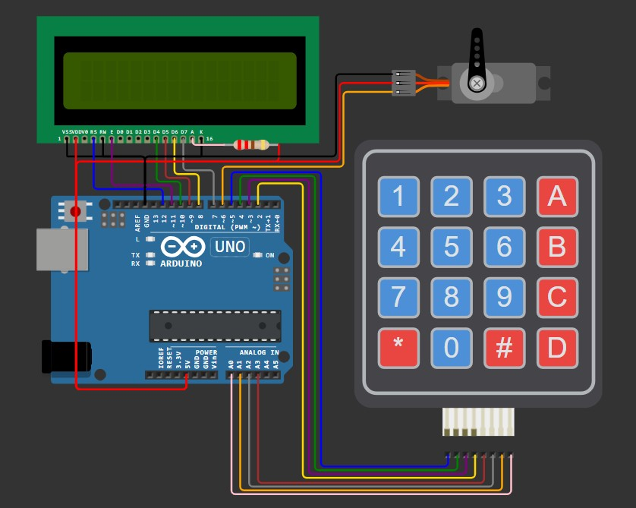
COMPONENTS REQUIRED
Liquid Crystal Display (LCD)
Servo Motor
Keypad
Arduino Uno

Slide 15

COMPONENTS EXPLANATION
Arduino Uno
Purpose: Acts as the brain of the system, coordinating the keypad input, LCD output, and servo motor control.
I/O Pins:
14 digital pins
6 analog input pins.
Power: Can be powered via USB or an external 9V/12V battery.
LCD (Liquid Crystal Display)
Type: 16x2 LCD (16 characters per line, 2 lines).
Usage:
Displays text to guide the user.
Interface:
Connected via 6 digital pins (D7 to D12 on Arduino).
Controlled using the
Liquid Crystal library.
15

Slide 16
Servo Motor
Keypad
Type: 4x4 Matrix Keypad.
Usage:
Takes user input, such as the 4-digit secret code.
Special keys (like ‘A’ and ‘#’) are used to set a new code or lock the safe.
Interface:
Row pins connected to
Arduino digital pins 2-5.
Column pins connected to
analog pins A0-A3.
Type: Standard servo motor (like SG90) with rotation typically limited to 180°.
Usage:
Controls the physical lock:
20° position: Locked.
90° position: Unlocked.
Interface:
Signal pin connected to digital
pin 6 on Arduino.
Power: Powered through the Arduino.
16

Slide 17

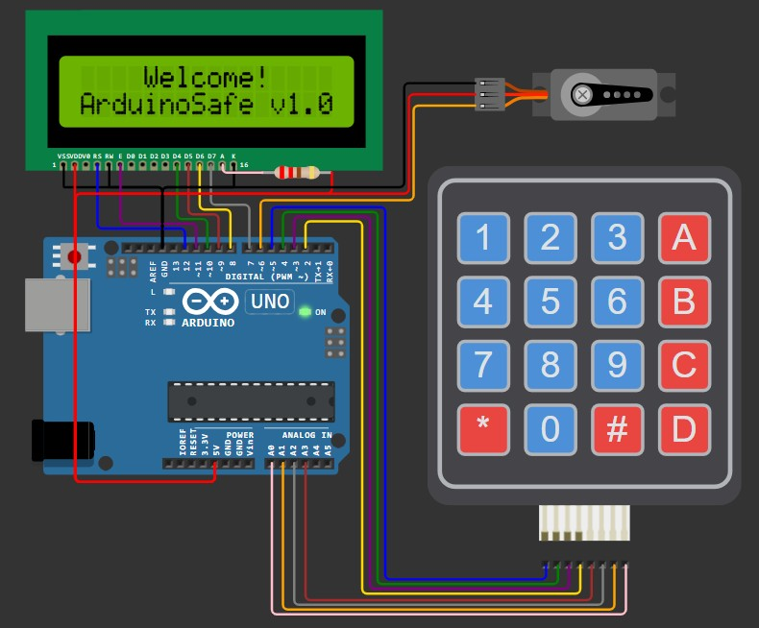
WORKING PRINCIPLE
System Initialization
Arduino initializes all components:
The LCD displays a welcome
message.
The servo motor is set to the correct position (locked or unlocked) based on the state stored in EEPROM.
If the safe is locked, the servo moves
to the locked position (20°).

Slide 18
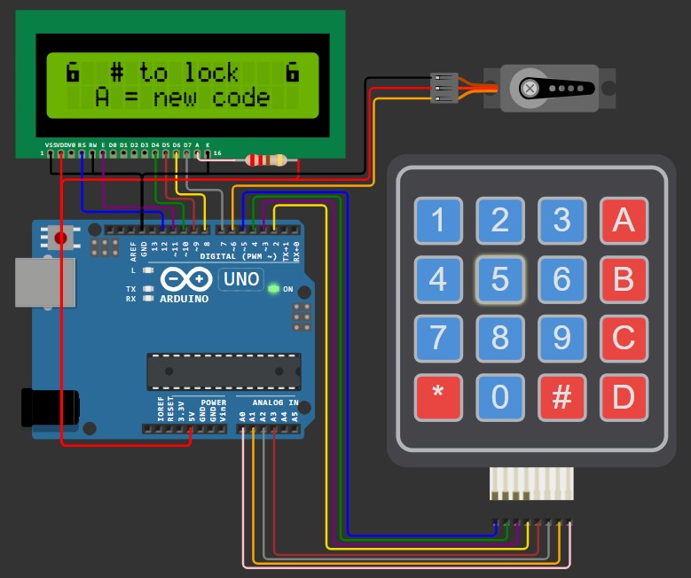
Input Mechanism (Keypad)
The 4x4 keypad is used to input:
Secret Code to unlock the safe.
Special commands like A (for setting a new code) and # (for locking).
Arduino reads the pressed key via row-column scanning of the keypad matrix.

Slide 19
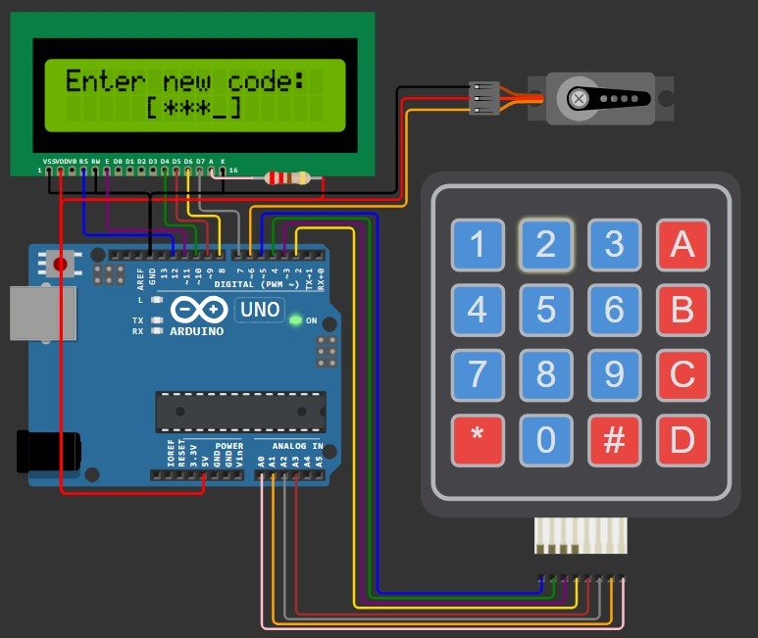
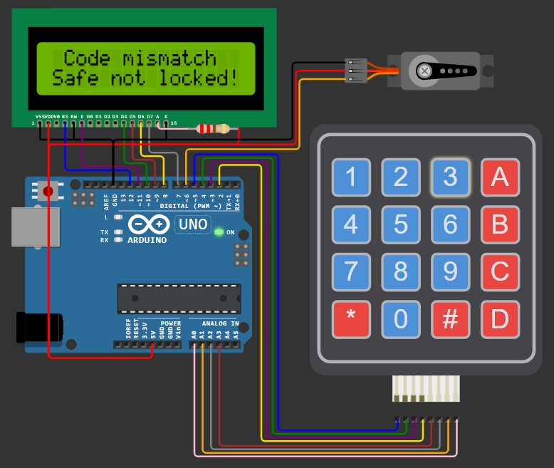
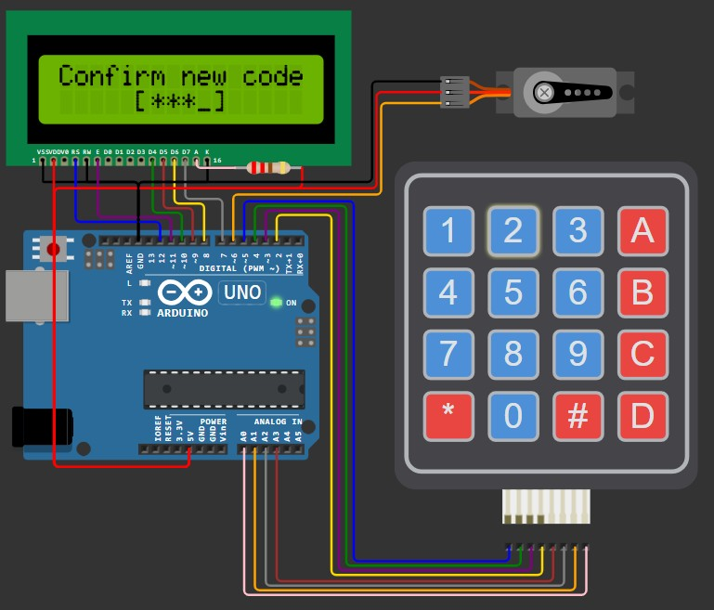
Setting a New Code
When the safe is unlocked, pressing A allows the user to set a new code:
The user enters the new 4-digit
code.
The code is confirmed by re- entering it.
If both inputs match, the new code is saved to EEPROM.
If there’s a mismatch, the process fails, and the LCD shows a message.

Slide 20
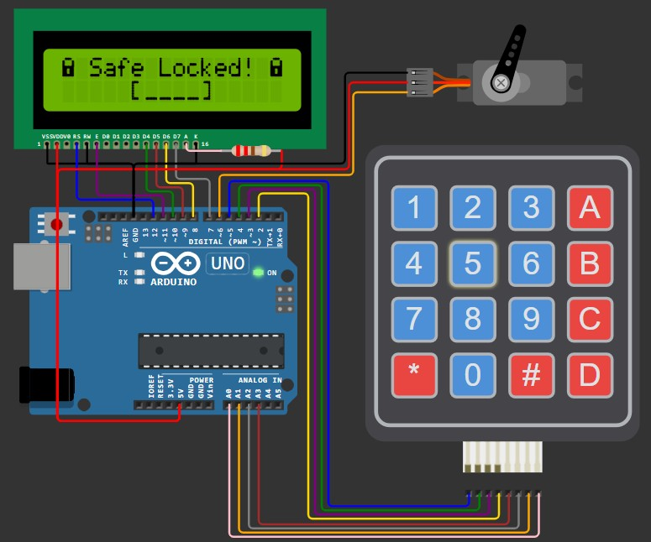
Locking Process
If the safe is unlocked:
The user can press # to lock the safe.
The servo motor rotates to 20° (locked position).
Arduino stores the state as locked in EEPROM for consistency on power resets.

Slide 21
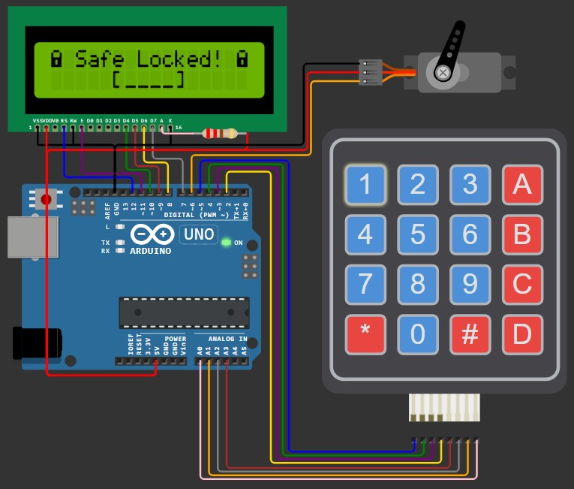
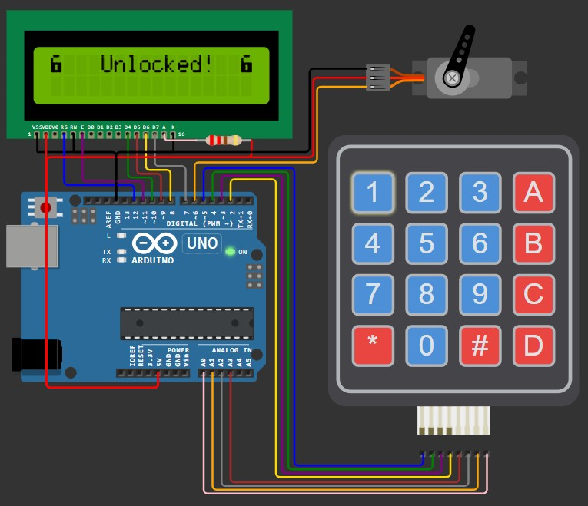
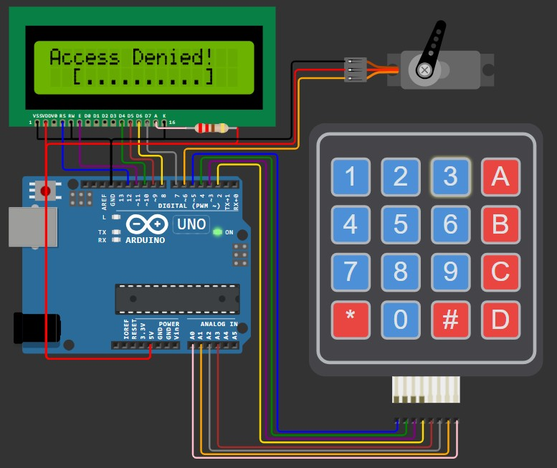
Unlocking Process
When the safe is locked, the user is
prompted to enter the 4-digit code.
Arduino compares the entered code with the stored code in EEPROM.
If the code matches:
The servo motor moves to the unlocked position (90°).
LCD displays "Unlocked!". 4.If the code is incorrect:
1. "Access Denied!" is shown on the
LCD, and the safe remains locked.

Slide 22

ALGORITHM
1. Initialization (setup)
Start the LCD display and initialize custom icons (if any).
Attach the servo motor to the specified pin.
Read the lock state from EEPROM.
If the state is locked, set the servo to locked position (20°).
If unlocked, set the servo to unlocked position (90°).
Display the startup message on the LCD.
2. Main Loop (loop function)
1. Check if the safe is locked or unlocked using the saved state.

Slide 23
3. Safe Locked Logic
If the safe is locked:
Display “Safe Locked” on the LCD.
Prompt the user to enter the secret code using the keypad.
Validate the entered code:
If the code matches the one stored in EEPROM:
Unlock the safe:
Move the servo to 90° (unlocked position).
Display "Unlocked!" on the LCD.
If the code is incorrect:
Display “Access Denied!” on the LCD.
Stay in the locked state.

Slide 24
4. Safe Unlocked Logic
If the safe is unlocked:
Display a message prompting the user to press # to lock or A to set a new code.
Wait for the user input:
If A is pressed:
Prompt the user to enter a new 4-digit code.
Ask the user to confirm the new code by re-entering it.
If the codes match:
Save the new code in EEPROM.
Display "Code Set!" on the LCD.
If the codes do not match:
Display "Code mismatch!" and return to the unlocked state.
If # is pressed:
Lock the safe:
Move the servo to 20° (locked position). Save the locked state in EEPROM.

Slide 25
5. Code Input Logic (inputSecretCode function)
Display a prompt to enter a 4-digit code.
Wait for the user to input 4 digits via the keypad.
o Display '*' for each digit as feedback.
Return the entered code.
6. Locking Process
1. Move the servo to the locked position (20°).
Save the locked state in EEPROM.
7. Unlocking Process
Move the servo to the unlocked position (90°).
Display "Unlocked!" on the LCD.

Slide 26
8. New Code Setting Logic (setNewCode function)
Display a message prompting the user to enter a new code.
Take the first input of 4 digits.
Ask the user to confirm the new code by entering it again.
If the two codes match:
Save the new code in EEPROM.
Return success.
If the codes do not match:
Display "Code mismatch!" and stay in the unlocked state.

Slide 27

CODE
Keypad keypad = Keypad(makeKeymap(keys), rowPins, colPins, KEYPAD_ROWS, KEYPAD_COLS);
/* LCD */
LiquidCrystal lcd(12, 11, 10, 9, 8, 7);
/* Servo */ Servo lockServo;
/* SafeState stores the secret code in EEPROM */ SafeState safeState;
/* Function prototypes */
void lock(struct SafeComponents *sc); void unlock(struct SafeComponents *sc);
String inputSecretCode(struct SafeComponents *sc); bool setNewCode(struct SafeComponents *sc);
void showStartupMessage(struct SafeComponents *sc); void showUnlockMessage(struct SafeComponents *sc); void showWaitScreen(struct SafeComponents *sc, int delayMillis);
void safeLockedLogic(struct SafeComponents *sc); void safeUnlockedLogic(struct SafeComponents *sc);
/* Create an instance of the SafeComponents structure */ struct SafeComponents sc = {&lcd, &keypad, &lockServo};
/* Lock the safe */
void lock(struct SafeComponents *sc) { sc->servo->write(SERVO_LOCK_POS); safeState.lock();
}
#include <LiquidCrystal.h> #include <Keypad.h> #include <Servo.h> #include "SafeState.h" #include "icons.h"
/* Define a structure to hold all components */ struct SafeComponents {
LiquidCrystal *lcd; Keypad *keypad; Servo *servo;
};
/* Locking mechanism definitions */ #define SERVO_PIN 6
#define SERVO_LOCK_POS 20
#define SERVO_UNLOCK_POS 90
/* Keypad setup */
const byte KEYPAD_ROWS = 4; const byte KEYPAD_COLS = 4;
byte rowPins[KEYPAD_ROWS] = {5, 4, 3, 2}; byte colPins[KEYPAD_COLS] = {A3, A2, A1, A0}; char keys[KEYPAD_ROWS][KEYPAD_COLS] = {
{'1', '2', '3', 'A'},
{'4', '5', '6', 'B'},
{'7', '8', '9', 'C'},
{'*', '0', '#', 'D'}
};
}
/* Unlock the safe */
void unlock(struct SafeComponents *sc) { sc->servo->write(SERVO_UNLOCK_POS);
}
16

Slide 28
/* Show startup message on the LCD */
void showStartupMessage(struct SafeComponents *sc) {
sc->lcd->setCursor(4, 0); sc->lcd->print("Welcome!"); delay(1000);
}
}
/* Set a new code for the safe */
bool setNewCode(struct SafeComponents *sc) { sc->lcd->clear();
sc->lcd->setCursor(0, 0);
sc->lcd->print("Enter new code:");
String newCode = inputSecretCode(sc);
sc->lcd->setCursor(0, 2);
String message = "ArduinoSafe v1.0";
for (byte i = 0; i < message.length(); i++) { sc->lcd->print(message[i]);
delay(100);
}
delay(500);
sc->lcd->clear();
sc->lcd->setCursor(0, 0);
sc->lcd->print("Confirm new code"); String confirmCode = inputSecretCode(sc);
}
if (newCode.equals(confirmCode)) {
safeState.setCode(newCode);
/* Input secret code using the keypad */
String inputSecretCode(struct SafeComponents | *sc) | { |  | return true;
sc->lcd->setCursor(5, 1); |  |  | } | else {
sc->lcd->print("[ ]"); |  |  |  | sc->lcd->clear();
sc->lcd->setCursor(6, 1); |  |  |  | sc->lcd->setCursor(1, 0);
String result = ""; |  |  |  | sc->lcd->print("Code mismatch");
while (result.length() < 4) { |  |  |  | sc->lcd->setCursor(0, 1);
char key = sc->keypad->getKey(); |  |  |  | sc->lcd->print("Safe not locked!");
if (key >= '0' && key <= '9') { |  |  |  | delay(2000);
sc->lcd->print('*'); |  |  |  | return false;
result += key; |  |  | }
} |  |  | }
}
return result;
/* Show unlock message */
void showUnlockMessage(struct SafeComponents *sc) { sc->lcd->clear();
sc->lcd->setCursor(0, 0);
sc->lcd->write(ICON_UNLOCKED_CHAR); sc->lcd->setCursor(4, 0);
sc->lcd->print("Unlocked!"); sc->lcd->setCursor(15, 0);
sc->lcd->write(ICON_UNLOCKED_CHAR); delay(1000);
}
/* Show wait screen */
void showWaitScreen(struct SafeComponents *sc, int delayMillis) { sc->lcd->setCursor(2, 1);
sc->lcd->print("[..........]"); sc->lcd->setCursor(3, 1);
for (byte i = 0; i < 10; i++) { delay(delayMillis);
sc->lcd->print("=");
17

Slide 29
/* Logic for when the safe is unlocked */
void safeUnlockedLogic(struct SafeComponents *sc) { sc->lcd->clear();
sc->lcd->setCursor(0, 0);
sc->lcd->write(ICON_UNLOCKED_CHAR); sc->lcd->setCursor(2, 0);
sc->lcd->print(" # to lock"); sc->lcd->setCursor(15, 0);
sc->lcd->write(ICON_UNLOCKED_CHAR);
/* Logic for when the safe is locked */
void safeLockedLogic(struct SafeComponents *sc) { sc->lcd->clear();
sc->lcd->setCursor(0, 0);
sc->lcd->write(ICON_LOCKED_CHAR); sc->lcd->print(" Safe Locked! "); sc->lcd->write(ICON_LOCKED_CHAR);
String userCode = inputSecretCode(sc);
bool unlockedSuccessfully = safeState.unlock(userCode); showWaitScreen(sc, 200);
if (unlockedSuccessfully) { showUnlockMessage(sc); unlock(sc);
} else {
sc->lcd->clear();
sc->lcd->setCursor(0, 0);
sc->lcd->print("Access Denied!"); showWaitScreen(sc, 1000);
}}
/* Setup function */ void setup() {
sc.lcd->begin(16, 2); init_icons(*sc.lcd); sc.servo->attach(SERVO_PIN);
/* Make sure the physical lock is sync with the EEPROM state */
Serial.begin(115200);
if (safeState.locked()) { lock(&sc);
} else {
unlock(&sc);
}
showStartupMessage(&sc);
}
/* Loop function */ void loop() {
if (safeState.locked()) { safeLockedLogic(&sc);
} else {
safeUnlockedLogic(&sc);
}}
bool newCodeNeeded = true;
if (safeState.hasCode()) { sc->lcd->setCursor(0, 1);
sc->lcd->print(" A = new code"); newCodeNeeded = false;
}
auto key = sc->keypad->getKey(); while (key != 'A' && key != '#') {
key = sc->keypad->getKey();
}
bool readyToLock = true;
if (key == 'A' || newCodeNeeded) {
readyToLock = setNewCode(sc);
}
if (readyToLock) { sc->lcd->clear();
sc->lcd->setCursor(5, 0);
sc->lcd->write(ICON_UNLOCKED_CHAR); sc->lcd->print(" ");
sc->lcd->write(ICON_RIGHT_ARROW); sc->lcd->print(" ");
sc->lcd->write(ICON_LOCKED_CHAR); safeState.lock();
lock(sc); showWaitScreen(sc, 100);
}}
18

Slide 30

ADVANTAGES
Increased Security: Prevents unauthorized access with code
protection.
User-Friendly Interface: Easy input and feedback for users.
Customizable: Allows for changing codes and settings as needed.
Automation: Reduces the need for manual locks, making it easier for elderly users.
19

Slide 31
High-Temperature and Gas Sensor
https://wokwi.com/projects/412811019007793153
Sumithra S
CB.SC.U4CSE23749

Slide 32
Objectives + Main Components
This part of the project is an Arduino Uno based sensor that alerts the occupants of the room when gas is detected or when the temperature of the room increases to an intolerable level indicative of a fire/overheating.
Arduino Uno | Reads inputs from sensors and turns them into outputs.
Gas Sensor | Takes gas levels of the room as input. An LED starts blinking if unhealthy gas levels are detected.
Temperature Sensor | Takes temperature of the room as input and changes the LED bar graph accordingly. A text message is also displayed in case of dangerous temperature levels.

Slide 33
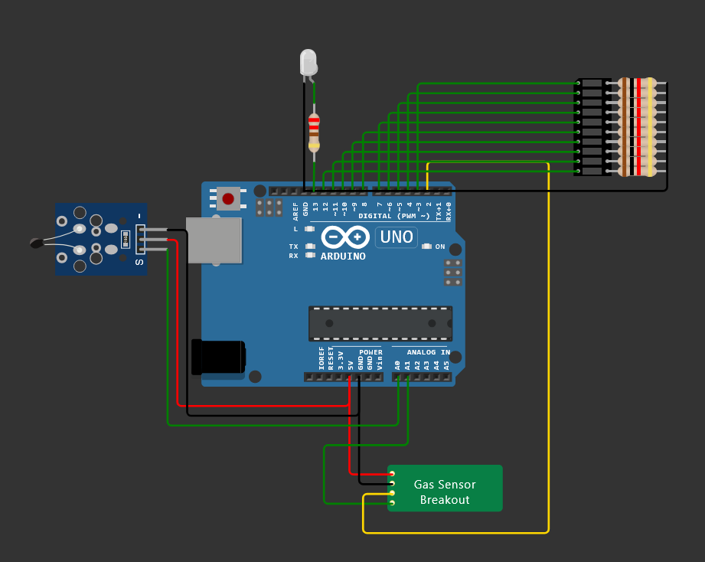
Wokwi Simulation
Gas Sensor Output LED
Temperature Sensor
Arduino Uno
Gas Sensor
Temperature Sensor Output LED Bar Graph

Slide 34
TEMPERATURE SENSOR
Decreases its resistance as the temperature increases.
This change in resistance alters the analog voltage output connected to an analog input pin on the Arduino.
The Arduino reads this analog value and calculates the corresponding temperature using a predefined formula or calibration curve.
POWER SUPPLY
GAS SENSOR
Decreases its resistance as the temperature increases.
This change in resistance alters the analog voltage output connected to an analog input pin on the Arduino.
The Arduino reads this analog value and calculates the corresponding temperature using a predefined formula or calibration curve.

Slide 35
TEMP. OUTPUT LED BAR GRAPH
Increases or decreases the number of bars displayed based on temperature.
A text message is also displayed during dangerous temperature levels.
ARDUINO UNO
Processes the analog readings from both sensors.
The Arduino also monitors the gas levels and temperature in real time through a loop.
GAS SENSOR OUTPUT LED
Starts blinking rapidly when dangerous gas levels are detected.
A text message is also displayed saying “Gas detected”.

Slide 36
ALGORITHM
1) Define Pins and Constants
1.1) Define analog and digital pins for the sensors.
1.3) Set the number of LEDs in the bar graph and assign their respective pins.
2) Setup Function
2.1) Begin serial communication at 9600 baud.
2.2) Set MQ2_ANA and MQ2_DIG as input pins.
2.3) Set the built-in LED as output.
2.4) Set all pins in the ledPins array as outputs to control the LED bar graph.
3) Loop Function
3.1) Gas Detection
3.1.1) Read the analog and digital values
from the MQ2 gas sensor.
3.1.2) If the reading is HIGH, print "Gas detected." and blink the LED.
3.2) Temperature Reading
3.2.1) Read the analog value from the temperature sensor.
3.2.2) If the temperature reading is below a certain threshold, print a warning message.
3.3) LED Bar Graph Display
3.3.1) Map the temperature reading.
3.3.2) Turn LEDs on up to the ledLevel to indicate temperature. Turn the remaining LEDs off.
3.4) Loop Delay
3.4.1) Wait for 1000 milliseconds before repeating the loop, allowing time for readings and visual updates.

Slide 37
ARDUINO CODE
#define MQ2_ANA A1
#define MQ2_DIG 2
#define TEMP_SENSOR A0
const int ledCount = 10; int ledPins[] = {3, 4, 5, 6, 7, 8, 9, 10, 11, 12}; // Pins for LEDs of bar graph
void setup() {
Serial.begin(9600);
pinMode(MQ2_ANA, INPUT);
pinMode(MQ2_DIG, INPUT);
pinMode(LED_BUILTIN, OUTPUT);
// Initialize LED pins as OUTPUT
for (int i = 0; i < ledCount; i++) {
pinMode(ledPins[i], OUTPUT);
}
}
void loop() {
// Read gas sensor values
float gas_analog = analogRead(MQ2_ANA);
int gas_digital = digitalRead(MQ2_DIG);
if (gas_digital == 1){
Serial.println("Gas detected.");
digitalWrite(LED_BUILTIN, HIGH); // turn the LED on (HIGH is the voltage level)
delay(10);
digitalWrite(LED_BUILTIN, LOW); // turn the LED off by making the voltage LOW
delay(10);
}
// Read temperature
float temperature = analogRead(TEMP_SENSOR);
if (temperature < 300){
Serial.println("Evacuate the room !");
}
else if (temperature < 450){
Serial.println("Temperature approaching dangerous levels...");
}
// Map temperature to LED levels
int ledLevel = map(temperature, 115, 953, 0, ledCount);
// Update LED bar graph
for (int i = 0; i < ledCount; i++) {
if (i < ledLevel) {
digitalWrite(ledPins[i], LOW); // Turn off LED
} else {
digitalWrite(ledPins[i], HIGH); // Turn on LED
}
}
delay(1000);
}

Slide 38
C CODE FOR GAS SENSOR
#include "wokwi-api.h" // Include Wokwi API for hardware simulation
#include <stdio.h>
#include <stdlib.h>
// Structure to hold the state of the MQ2 chip
typedef struct {
pin_t pin_ao; // Analog output pin for gas concentration
pin_t pin_do; // Digital output pin for gas detection threshold
pin_t pin_vcc; // VCC pin for power supply
pin_t pin_gnd; // GND pin for ground connection
uint32_t gas_attr; // Attribute for gas concentration percentage
uint32_t threshold_attr; // Attribute for clean air threshold
} chip_state_t;
// Forward declaration of the timer event handler
static void chip_timer_event(void *user_data);
// Function to initialize the MQ2 chip
void chip_init(void) {
chip_state_t *chip = malloc(sizeof(chip_state_t));
// Initializing pins
chip->pin_ao = pin_init("AO", ANALOG); // Set AO pin as ANALOG input
chip->gas_attr = attr_init("gas", 10); // Initialize gas attribute with default value
chip->threshold_attr = attr_init("threshold", 50); // Initialize threshold attribute
chip->pin_do = pin_init("DO", OUTPUT_LOW);
chip->pin_vcc = pin_init("VCC", INPUT_PULLDOWN);
chip->pin_gnd = pin_init("GND", INPUT_PULLUP);
// Configure timer for periodic updates
const timer_config_t timer_config = {
.callback = chip_timer_event, // Set the callback function for the timer
.user_data = chip, // Pass the chip state to the callback
};
timer_t timer_id = timer_init(&timer_config); // Initialize timer
timer_start(timer_id, 1000, true); // Start timer to call every 1000 ms (1 second)
}
// Timer event handler function
void chip_timer_event(void *user_data) {
chip_state_t *chip = (chip_state_t*)user_data; // Cast user_data to chip state
// Read gas and threshold attributes as float values
float voltage = (attr_read_float(chip->gas_attr)) * 5.0 / 100; // Convert gas % to voltage
float threshold_v = (attr_read_float(chip->threshold_attr)) * 5.0 / 100; // Convert threshold % to voltage
// Check if power is supplied correctly
if (pin_read(chip->pin_vcc) && !pin_read(chip->pin_gnd)) {
pin_dac_write(chip->pin_ao, voltage); // Write voltage to AO pin
// Check if the gas concentration exceeds the threshold
if (voltage > threshold_v)
pin_write(chip->pin_do, HIGH); // Set DO pin HIGH if threshold is exceeded
else
pin_write(chip->pin_do, LOW); // Set DO pin LOW if below threshold
}
}

Slide 39
ADVANTAGES
Early detection of hazards
Cost-effective
Customizable and scalable
Easy maintenance
Real-time alerts
Low power consumption
Arduino is open-source. This provides flexibility.

Slide 40
Thank You!

Slide 41
AUTOMATIC WATER LEVEL CONTROLLER
- Using Aurdino
V SANJANA
CB.SC.U4CSE23751
LINK: https://wokwi.com/projects/413080809543126017

Slide 42
OBJECTIVES OF THE SENSOR
The main objective of the sensor in the code above is to
Measure - the water level in a tank .
Automate pump - control based on predefined thresholds to maintain an optimal water level.
Monitor Water Level - The ultrasonic sensor measures the distance to the water surface, calculating the water level as a percentage relative to a threshold.
2.Control Pump Automatically:
In AUTO mode, the pump is turned ON if the water level drops below 30% and turned OFF if it reaches or exceeds 100%.
In MANUAL mode, the pump state can be toggled manually.
3. Display Information: The LCD shows the current water level percentage, pump status (ON/OFF), and operational mode (AUTO/MANUAL), providing real-time feedback for easy monitoring.

Slide 43
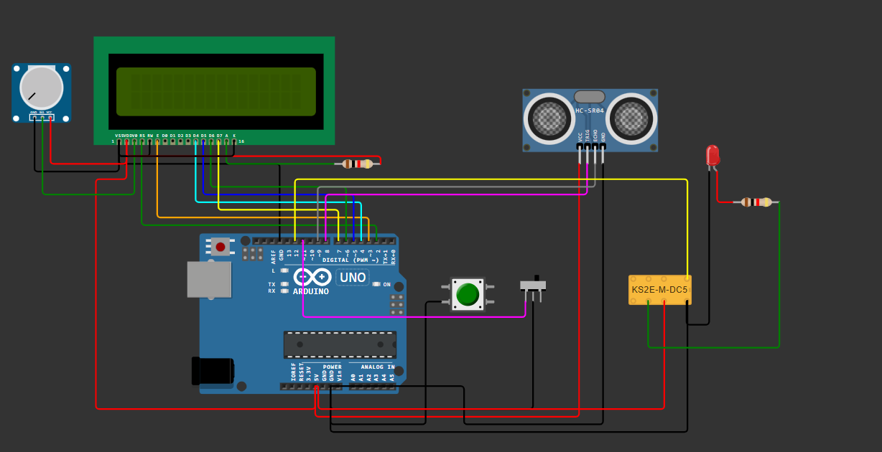
CIRCUIT DESIGN AND COMPONENTS REQUIRED
LCD Display
Resistors
Pressure sensor
Potentiometer
Push button
LED
Slide switch
Aurdino UNO
DPDT Relay

Slide 44
ALGORITHM
1.Initialize:
Set up the LCD, sensor, buttons, and pump control pins.
Read the initial water level threshold from memory (EEPROM) limiting it to a maximum value of 150.
2.Measure Water Level:
Send an ultrasonic pulse and calculate the water level in inches from the echo received.
Convert this level to a percentage based on the set threshold.
3.Display Water Level and Pump Status:
Show the water level percentage on the LCD.
Display whether the pump is ON or OFF and the current mode (AUTO/MANUAL).
4.Control Pump:
AUTO Mode:
Turn the pump ON if the water level is below 30%.
Turn the pump OFF if the water level reaches or exceeds 100%.
MANUAL Mode:
Allow the pump to be toggled ON or OFF manually with a button.
5.Set New Threshold (Only in AUTO Mode):
If the "set" button is pressed, update the water level threshold based on the current measurement and save it to memory
6. Repeat:
Wait for a short delay and repeat the measurement and control steps.
This loop continues, ensuring real-time monitoring and control of the water level and pump status.

Slide 45
C CODE
#include <EEPROM.h>
#include <LiquidCrystal.h>
// Initialize LCD with the specified pin configuration
LiquidCrystal lcd(2, 3, 4, 5, 6, 7);
// Structure to hold water level data
struct WaterLevelData {
long inches;
int set_val;
int percentage;
};
// Create an instance of the structure
WaterLevelData waterLevel;
// Pointer to the waterLevel structure
WaterLevelData *waterLevelPtr = &waterLevel;
long duration;
bool state, pump;
void setup() {
lcd.begin(16, 2);
lcd.print("WATER LEVEL: ");
lcd.setCursor(0, 1);
lcd.print("PUMP:OFF MANUAL");
// Set pin modes for pins 8 to 12
for (int pin = 8; pin <= 12; ++pin) {
if (pin == 8 || pin == 12) {
pinMode(pin, OUTPUT);
} else {
pinMode(pin, INPUT_PULLUP);
}
}
waterLevelPtr->set_val = EEPROM.read(0);
if (waterLevelPtr->set_val > 150) {
waterLevelPtr->set_val = 150;
}
}
void loop() {
digitalWrite(3, LOW);
delayMicroseconds(2);
digitalWrite(8, HIGH);
delayMicroseconds(10);
digitalWrite(8, LOW);
duration = pulseIn(9, HIGH);
// Calculate and display inches and percentage values using pointers
waterLevelPtr->inches = microsecondsToInches(duration);
waterLevelPtr->percentage = (waterLevelPtr->set_val - waterLevelPtr->inches) * 100 / waterLevelPtr->set_val;
// Display the percentage value on LCD
lcd.setCursor(12, 0);
if (waterLevelPtr->percentage < 0) waterLevelPtr->percentage = 0;
lcd.print(waterLevelPtr->percentage);
lcd.print("% ");
// Pump control logic based on water level percentage using pointer
if (waterLevelPtr->percentage < 30 & digitalRead(11)) pump = 1;
if (waterLevelPtr->percentage > 99) pump = 0;
digitalWrite(12, !pump);
// Display pump status on LCD
lcd.setCursor(5, 1);
if (pump == 1) lcd.print("ON ");
else if (pump == 0) lcd.print("OFF");
// Display mode status on LCD (MANUAL or AUTO)
lcd.setCursor(9, 1);
if (!digitalRead(11)) lcd.print("MANUAL");
else lcd.print("AUTO ");
// Adjust threshold if button is pressed in AUTO mode
if (!digitalRead(10) & !state & digitalRead(11)) {
state = 1;
waterLevelPtr->set_val = waterLevelPtr->inches;
EEPROM.write(0, waterLevelPtr->set_val);
}
// Toggle pump if button is pressed in MANUAL mode
if (!digitalRead(10) & !state & !digitalRead(11)) {
state = 1;
pump = !pump;
}
// Reset state when button is released
if (digitalRead(10)) state = 0;
delay(500);
}
// Function to convert microseconds to inches
long microsecondsToInches(long microseconds) {
return microseconds / 74 / 2;
}

Slide 46
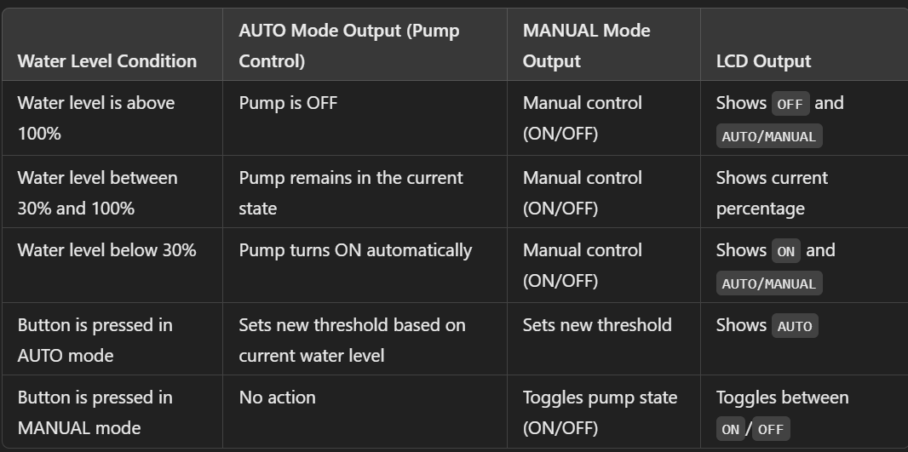
OUTPUT SPECIFICATIONS

Slide 47
Automated Operation Prevention of Overflow and Dry Running
Efficiency and Resource Conservation
Improved Safety
Data Monitoring and Management
ADVANTAGES OF THE ABOVE SENSOR

Slide 48
THANK YOU

